Slide 1
Machine Learning-Based Data-Driven Traffic Flow Estimation from Mobile Data
Pei-Lun Hsu
10.05.2021

Slide 2
Contents
Introduction
Backgrounds
Datasets and Methodology
Results
Discussion
Conclusion and Future work

Slide 3
Introduction

Slide 4
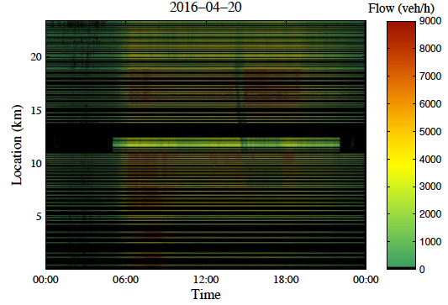
Background & Problems
Background: Comprehensive information on traffic flow is essential for traffic control and vehicular emission monitoring.
Problem: Traffic flow information is not observable everywhere and anytime on the road because of high installation costs and malfunctions of stationary sensors, e.g., radar detector.
Figure: Traffic flow data from stationary detectors.
Reprinted from N. Tsanakas, Emission estimation based on traffic models and measurements. Linköping University Electronic Press, 2019, vol. 1835. ISBN 9176850927 [2]

Slide 5
Goal and Purpose
Goal: Propose and analyze an approach for inferring traffic flows from mobile data (INRIX) with wide spatial coverage to compensate for stationary sensors' weakness.
The idea is to develop Artificial Neural Network (ANN)-based models to automatically extract relations between traffic flow and mobile data measurements from historical datasets considering temporal and spatial dependencies, and then use real-time mobile data as model's inputs to inference the traffic flow.
We aim to provide a highly automated means to process sensor data and build estimation models for Intelligent Transport Systems (ITS) in the context of the Internet of Things (IoT) and Big Data.

Slide 6
Backgrounds

Slide 7
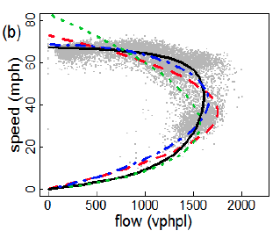
Traffic State Variables
Three traffic state variables are widely used to describe the traffic flow conditions on the highway.
Traffic Flow (veh/h): The number of vehicles traveling through a particular point on the road per unit of time.
Speed (km/h): Average speed of vehicles.
Density (veh/km): The number of vehicles per unit of distance.
Figure: Example of flow-speed relation.
Reprinted from K. Anuar, F. Habtemichael, and M. Cetin, “Estimating traffic flow rate on freeways from probe vehicle data and fundamental diagram,” in 2015 IEEE 18th International Conference on Intelligent Transportation Systems. IEEE, 2015, Conference Proceedings. ISBN 1467365963 pp. 2921–2926.

Slide 8
Sensor Data Types
The traffic measurement data can be grouped into two categories based on the ways they are collected.
Stationary Data:
Collected by fixed-location sensors installed on highways, e.g., inductive loop and radar detector.
Can provide measures of traffic flow and speed at the same time.
Mobile Data:
Collected by on-vehicle sensors, e.g., GPS-enabled smartphones and navigation systems.
Has broader spatial coverage but cannot provide direct measures of traffic flow.

Slide 9
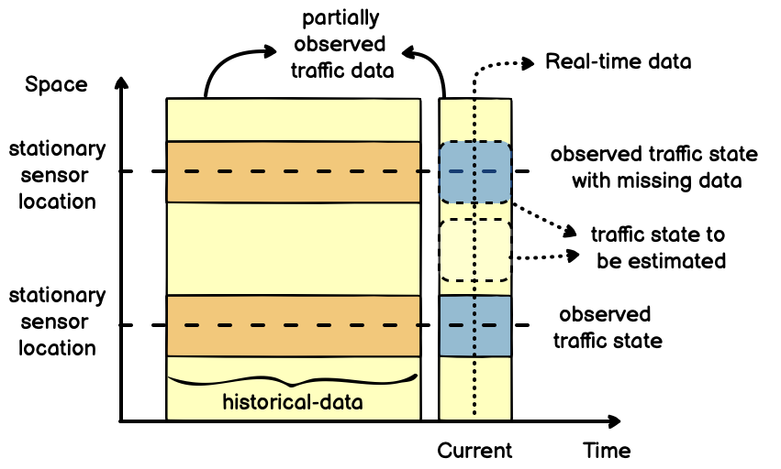
Traffic State Estimation (TSE) and Imputation
TSE aims to estimate the unobserved traffic state variables using partially observed and noisy traffic data in regions where stationary sensors are absent.
Imputation aims to impute traffic datasets collected from locations where the traffic state variables are observed but suffer from missing or corrupted data.
Figure: Relation between traffic data and traffic states in the space-time domain.

Slide 10
Related Works
Previous TSE approaches using mobile data:
Used static and/or univariate traffic flow relationships (usually flow-speed relation) → time- and space-varying and depends on multiple factors
Required functional form selection and model parameter calibration by human experts → not automated and hence not scalable solution
Previous approaches for traffic flow imputation:
Did not utilize alternative data sources to impute the missing or corrupted traffic flow data.

Slide 11
Datasets and Methodology

Slide 12
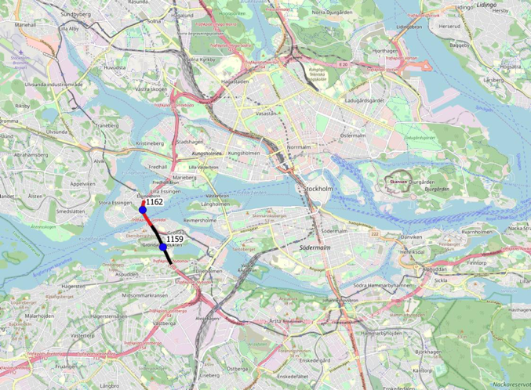
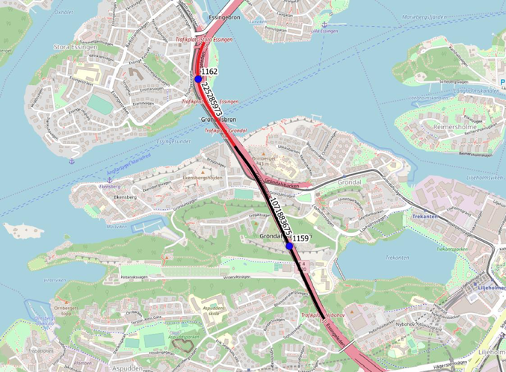
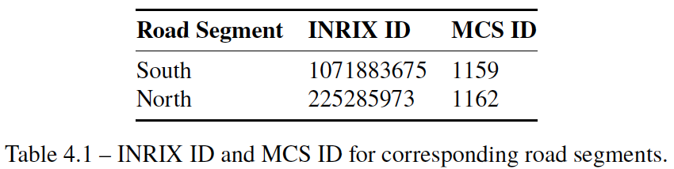
Datasets
The data were collected from INRIX (mobile) and MCS (radar) sensors on two consecutive road segments on the E4 highway, in Stockholm from 01.10.2018 to 28.10.2018.

Slide 13
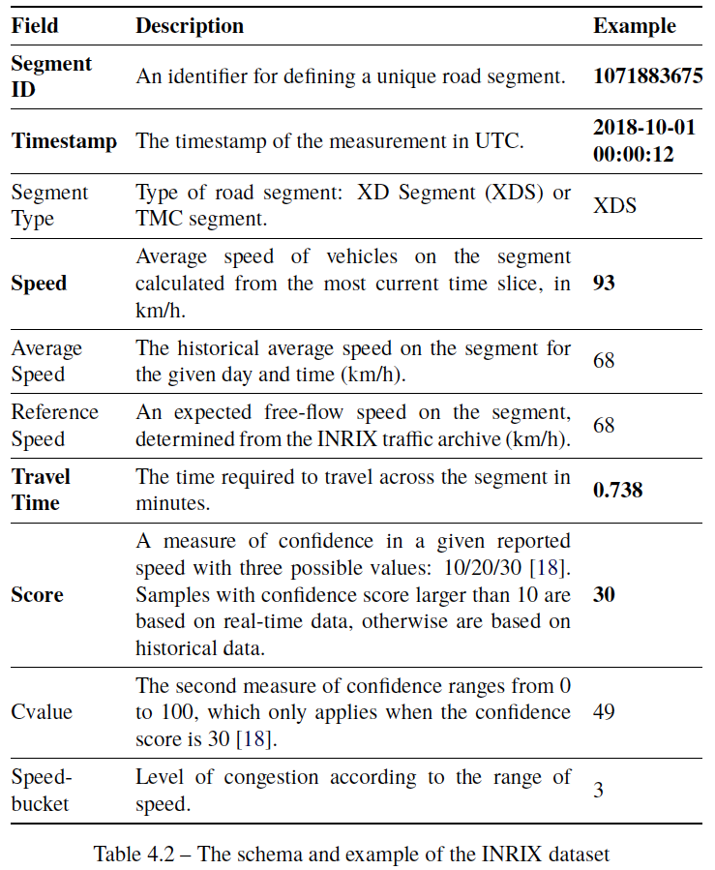
Mobile Data: INRIX
Crowd-sourced traffic data platform provides traffic information every minute based on data collected from GPS-enabled vehicles and smartphones.

Slide 14
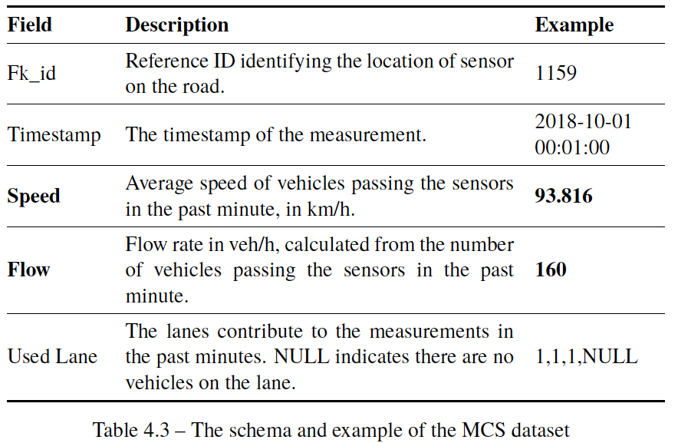
Stationary Data: Motorway Control System (MCS)
Radar sensor system installed on gantries on roads in Stockholm for monitoring traffic by the Swedish transport administration (Trafikverket).
MCS delivers information on traffic flow and speed every minute.

Slide 15
Training & Test Datasets
Training set: Data from the south road segment, 1st to 21st Oct
A special training set only for the spatial-temporal ANN model: Data from both north and south segments, 1st to 21st, Oct
Test set: Data from both north and south segments, 22nd to 28th Oct
Technology Set: Python, pandas, scikit-learn, Keras/TensorFlow, Jupyter-Notebook, Google Colab, Google Cloud AI Platform

Slide 16
Data Preparation
Following typical data processing methods are adopted for preparing the training and test datasets:
Filtering: Remove the data points with a low confidence score (10) in INRIX datasets.
Smoothing: Use moving average with a window width of 30 time-steps to remove noise in the measures of traffic variables, i.e., flow and speed, in INRIX and MCS datasets.
Shifting: Shift the INRIX time-series data by 360 sec to eliminate the latency of speed observed in INRIX data compared with the MCS speed.

Slide 17
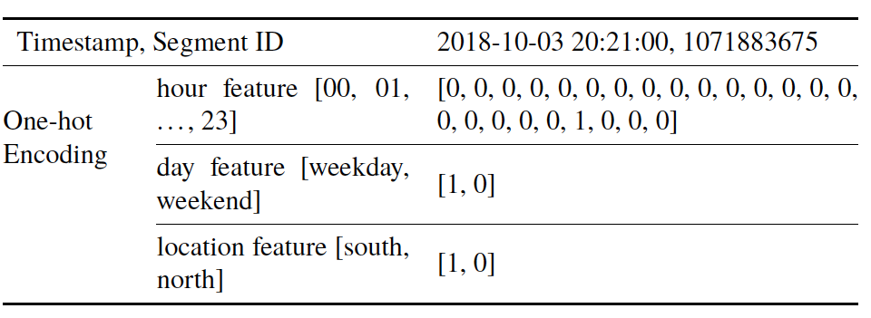
Feature Engineering: One-Hot Encoding
One-hot encoding is used to convert timestamps and segment IDs into numerical time and space features for training ANN models:
hour feature: "hour" in the timestamp is converted into a 24-bit one-hot code, representing the hour of a day.
day feature: "day" in the timestamp is converted into a 2-bit one-hot code, representing the day of a week, i.e., weekdays or weekends.
location feature: "segment ID" is converted into a 2-bit one-hot code, representing the location of the road segment, i.e., the south or north segment.

Slide 18
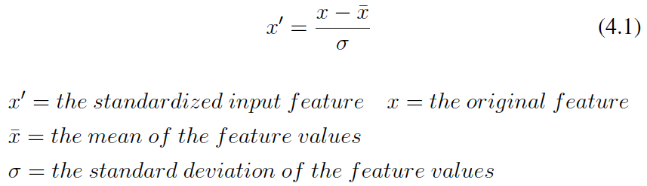
Feature Scaling: Standardization
Machine learning algorithm requires its input features to have a similar scale to perform correctly.
Standardization is a common method to scale numerical attributes.
It subtracts the mean value from the input features and divides them by the standard deviation.

Slide 19
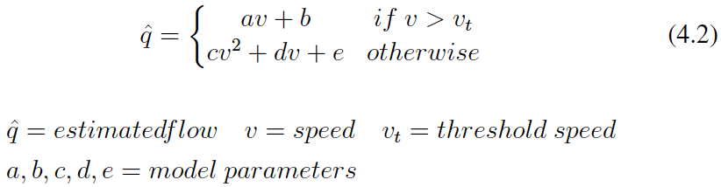
Baseline Model
A multi-regime regression model is built as the baseline model to capture the classic flow-speed relationship using different functional forms in different traffic conditions.
The baseline model will be used to compare with the ANN models.
Note: Threshold speed of 70 km/h separates the samples into free-flow and non-free-flow conditions.

Slide 20
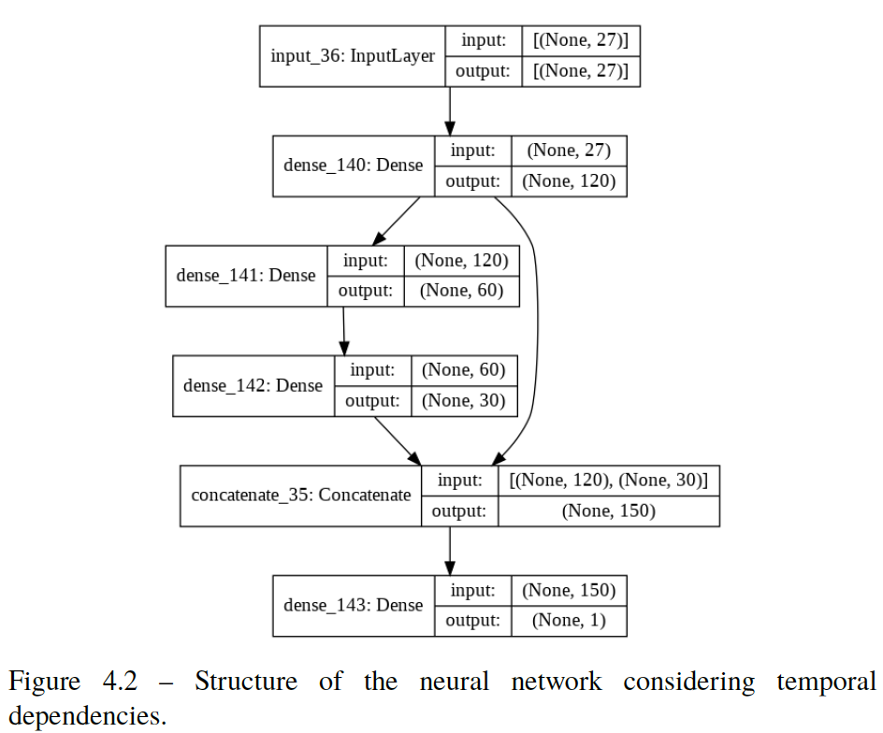
ANN Model Structure
ANN is a data-driven/non-parametric machine learning (deep learning) method with the following advantages:
Adaptive to data
Good in learning nonlinear and complex relationships in high-dimensional data

Slide 21
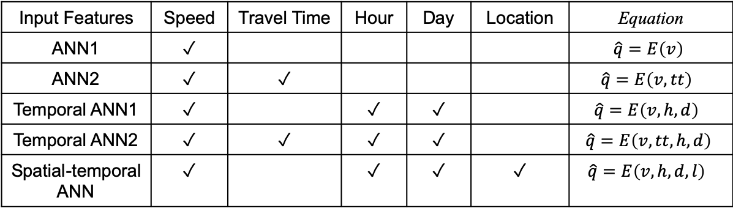
ANN Models
Five ANN models are developed to extract:
Static flow-speed relationship
Flow-speed relationships considering temporal and spatial dependencies.
Traffic flow relationship between multiple input variables in a multivariate setting.
Input Features | Speed | Travel Time | Hour | Day | Location | Equation
ANN1 | ✓ |  |  |  |  | $$\hat{q}=E\left(v\right)$$
ANN2 | ✓ | ✓ |  |  |  | $$\hat{q}=E\left(v, tt\right)$$
Temporal ANN1 | ✓ |  | ✓ | ✓ |  | $$\hat{q}=E\left(v, h,d\right)$$
Temporal ANN2 | ✓ | ✓ | ✓ | ✓ |  | $$\hat{q}=E\left(v, tt, h,d\right)$$
Spatial-temporal ANN | ✓ |  | ✓ | ✓ | ✓ | $$\hat{q}=E\left(v, h,d, l\right)$$

Slide 22
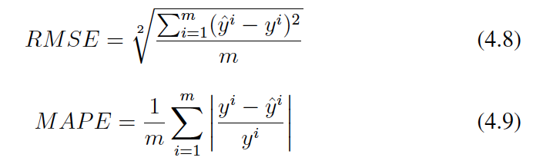
Performance Evaluation
The root mean squared error (RMSE) and the mean absolute percentage error (MAPE) are used to evaluate the models' accuracy.

Slide 23
Results

Slide 24
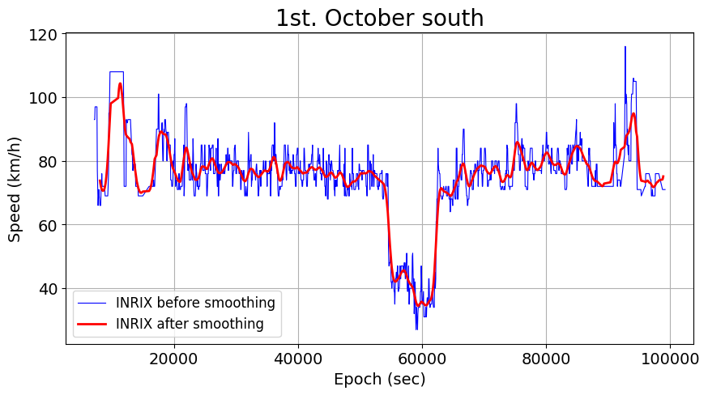
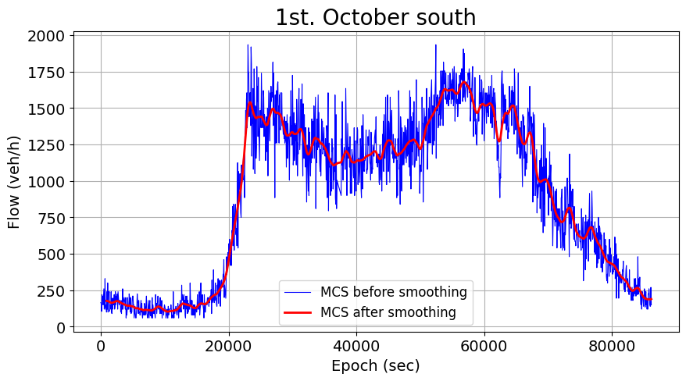
Data Preparation: Smoothing
To remove noise in the INRIX and MCS time-series data, i.e., speed and flow, and expose the variable values that represent the trends.
Moving average with a window width of 30 timesteps (30 mins).

Slide 25
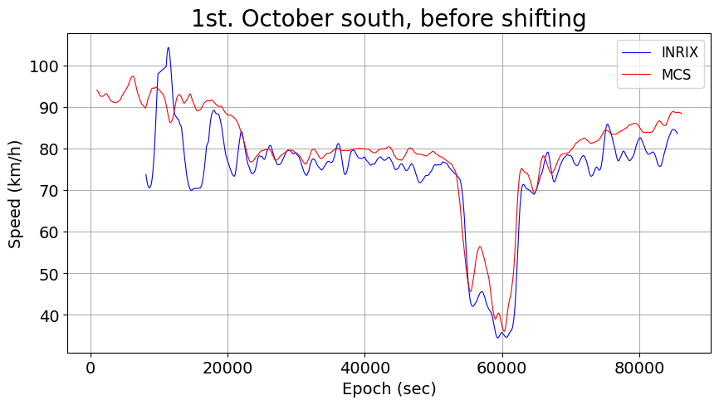

Data Preparation: Shifting
6-minute latency of speed is observed in INRIX datasets compared with the MCS speed.
Shift the INRIX timestamps by 360 sec to remove the time-lag between two measurements
Shift
360s
Notes:
The prediction of flow based on the epoch(time) in 9 days range:
1. The accuracy of flow prediction over a month is very low (R2: 0.25, RMSE: 450) when using polynomial regression with time Epoch (x, x^2, x^3, ...) as features.
2. It is difficult to use linear regression to capture the behavior of flow over a wide range of time as it is not a linear function of time.
3. What if we use polynomial regression to fit/predict the flow in one day range and use the same model to predict the flow on other days based on its periodic characteristic? We might be able to obtain a higher accuracy by doing that.

Slide 26
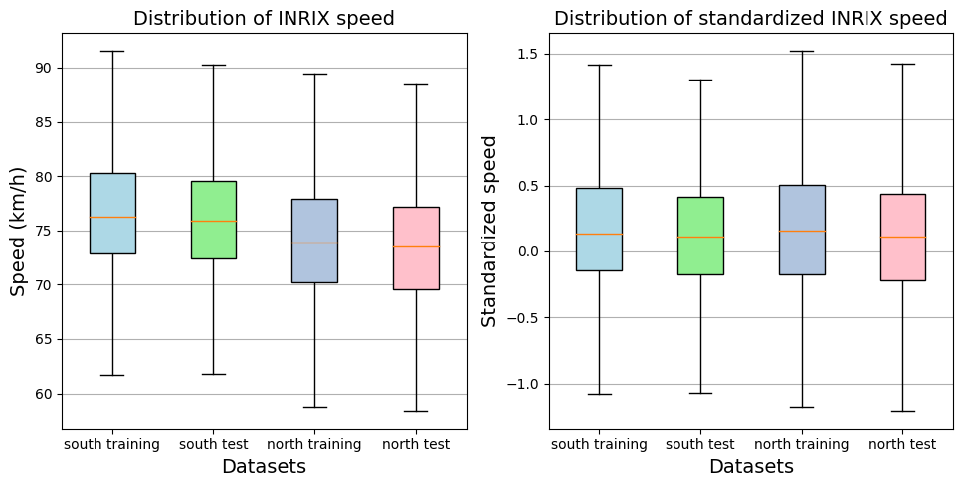
Data Preparation: Feature Standardization
North segment’s median speed before the standardization is approximately 3 km slower than median speed on the south segment.
After standardization, both segments’ median speed and interquartile ranges are similar.

Slide 27
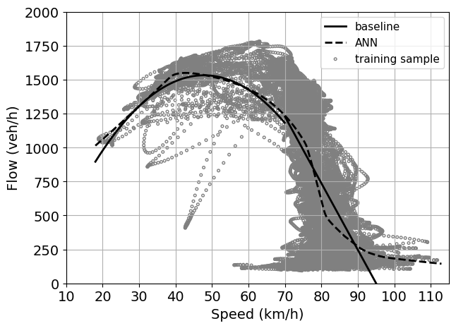
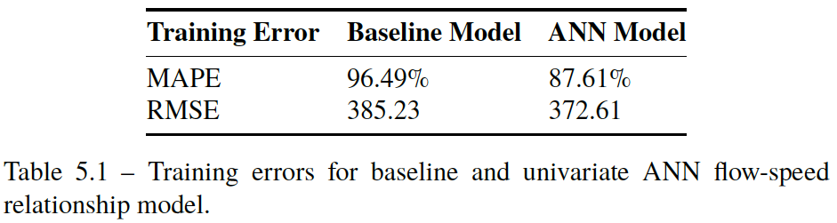
Model Training: Baseline Model vs. ANN Model
The ANN flow-speed relation fits the training samples better than the baseline relation, especially in the free-flow regime.
However, a deterministic curve could not capture the flow variation given the same speed under different traffic conditions.

Slide 28
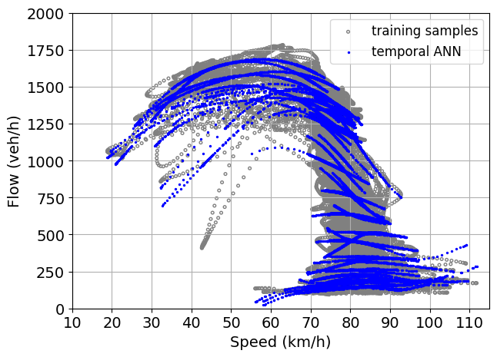
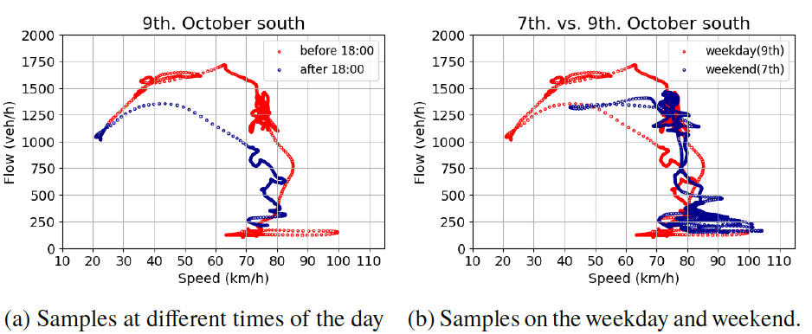
Model Training: ANN with Temporal Dependency
People’s daily and weekly routine activities influence the traffic conditions on the road.
Temporal ANN learned many micro-relations for different time segments to capture the changes of traffic conditions over time.

Slide 29
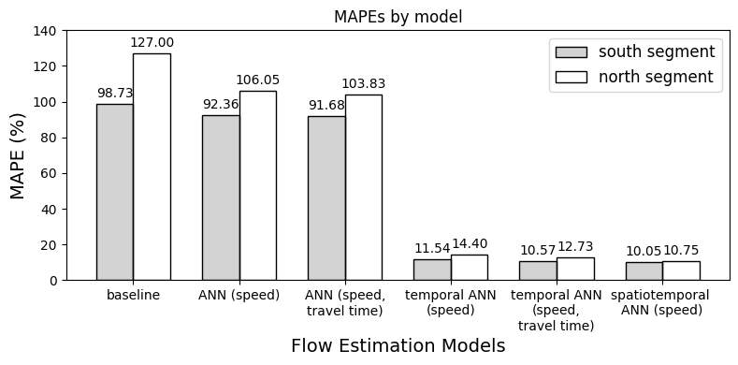
Traffic Flow Estimations
All models are validated on the south and north test dataset collected in a week.
Models generally perform better on the south segment, where the models were trained, than on the north segment, except the spatiotemporal ANN model.
Generally speaking, the models’ performance improves when we incorporate new dependency.

Slide 30
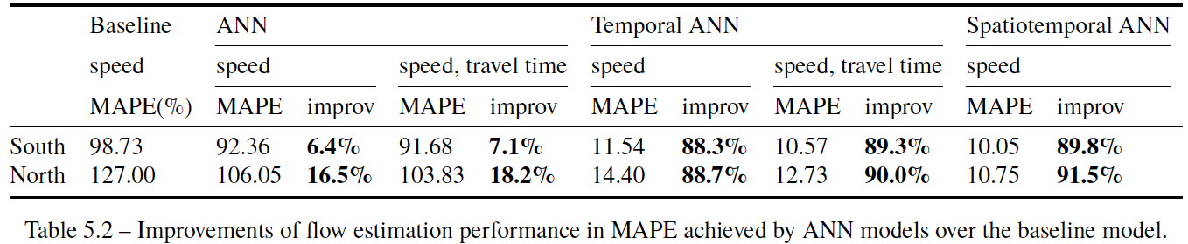
Traffic Flow Estimations: Comparison
All ANN models outperformed the baseline model.
Incorporating temporal factors improves the performance considerably (~90%).
Travel time as an additional information source contributes tiny improvements.
ANN models generally achieve more improvements on the north segment than on the south segment.

Slide 31
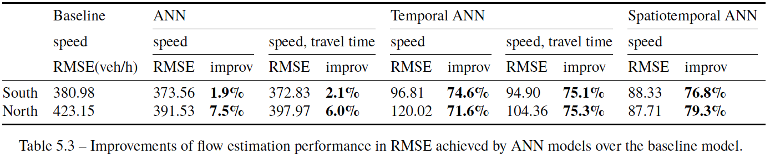
Traffic Flow Estimations: RMSE
The overall trend of performance in RMSE is similar to the trend in MAPE.
However, incorporation of travel time could slightly degrade the ANN’s performance on the north segment.

Slide 32
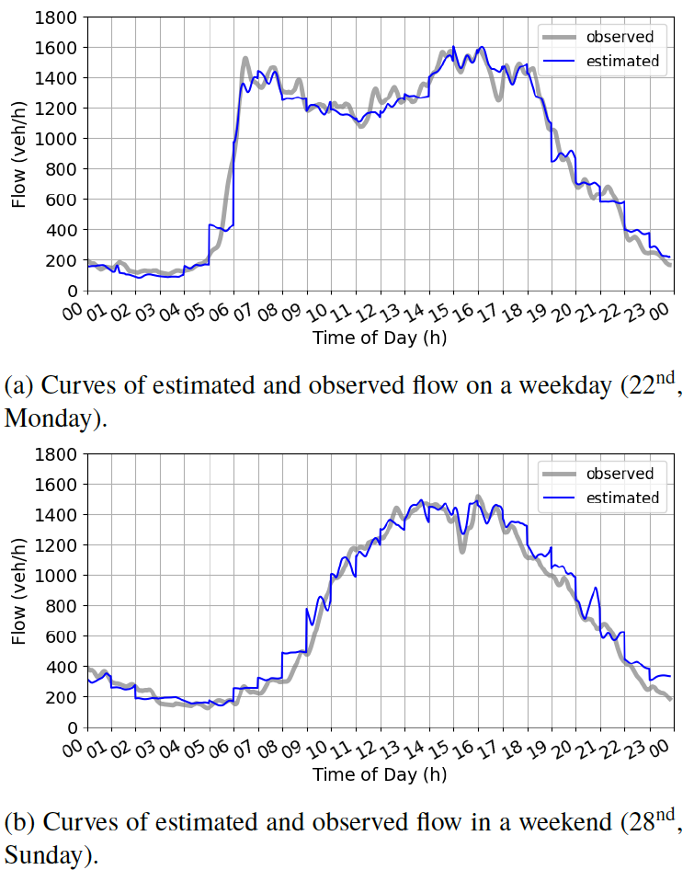
Estimated Flows on South Segment in a Day
The temporal ANN model successfully captures the typical two-peak flow pattern on a weekday and the one-peak pattern on the weekend.
Discontinuities are observed at the transitions between hours, especially when the traffic flow changes sharply.

Slide 33
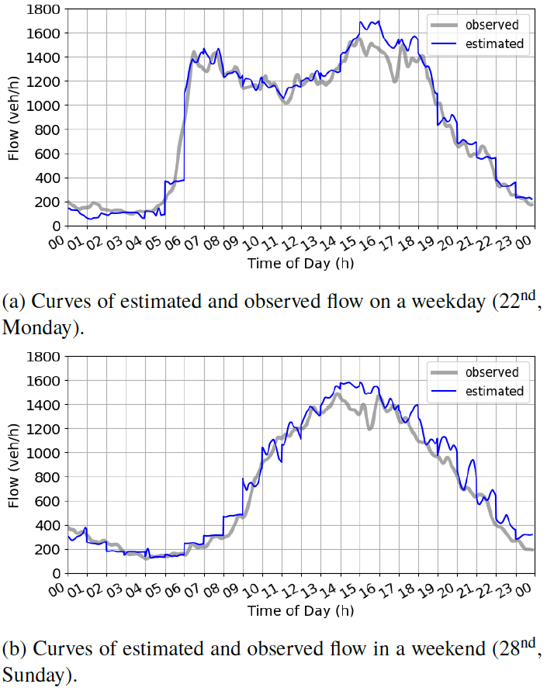
Estimated Flow on North Segment in a Day
The temporal ANN model also works well most of the time on the north segment.
It tends to overestimate the traffic flow when the flow is near the capacity because the north segment’s traffic flow characteristics are slightly different.

Slide 34
Discussion

Slide 35
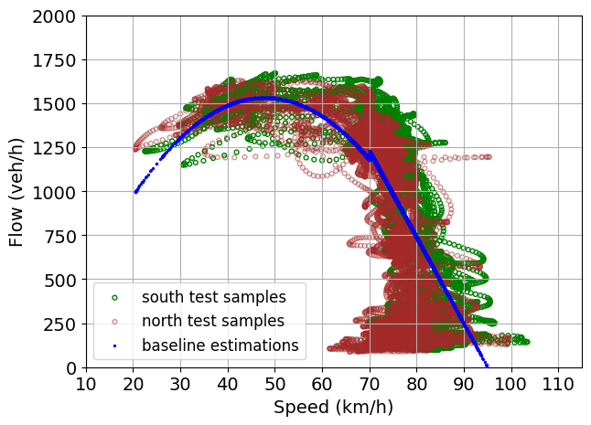
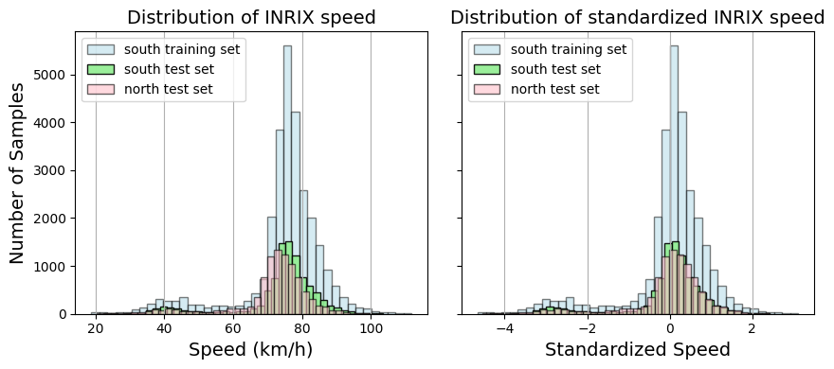
Input Speed Drift: Baseline Model
The speed on the north segment is slightly lower than the south segment’s speed, especially in the free-flow regime.
The mismatch between input speeds and the calibrated baseline model leads to larger performance degradation on the north segment.

Slide 36
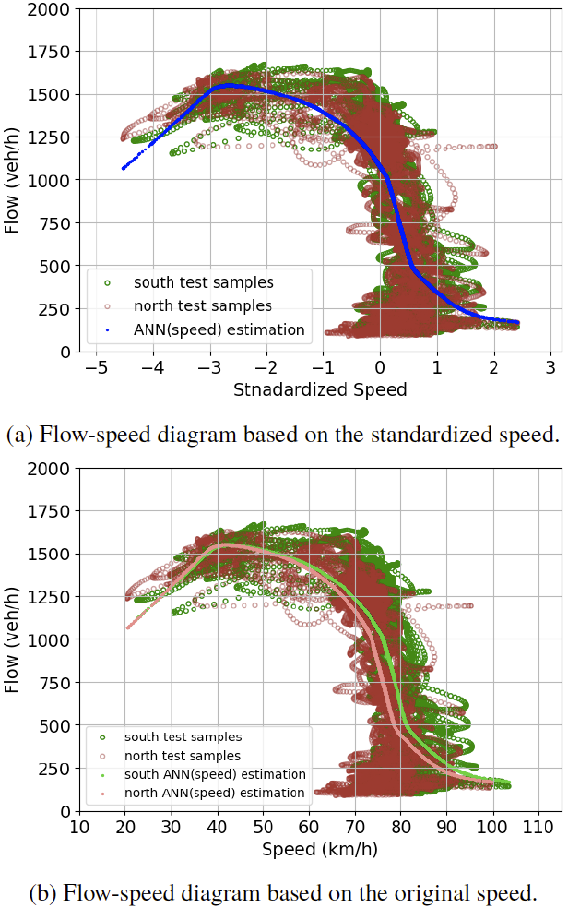
Input Speed Drift: ANN Models
Standardization mitigates the difference of speeds on adjacent road segments.
ANNs’ flow-speed relation was trained on the standardized speed.
Feature standardization gives ANNs better resistance to the input drifts on different road segments.

Slide 37
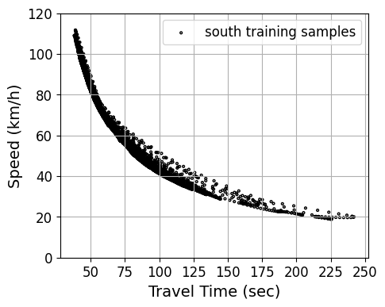
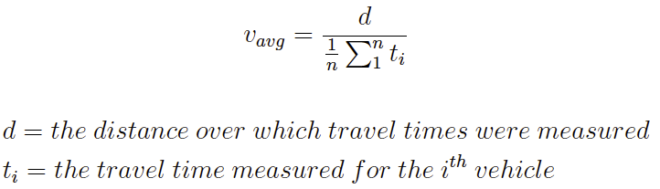
Travel Time
Mobile data calculate the speed as space mean speed.
Speed and travel time are inversely proportional to each other.
Travel time as an additional input provides limited information for estimation.
However, it may complement speed when the speed value is small.

Slide 38
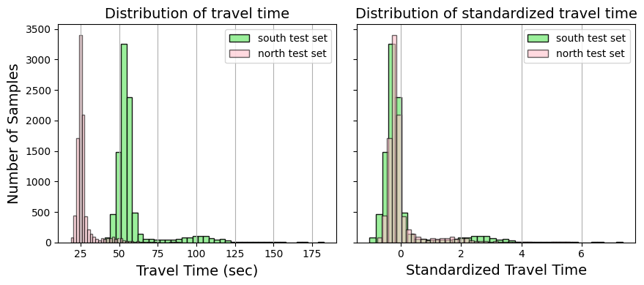
Travel Time Drift
The drift of travel time on the north segment is more severe than the speed drift.
Standardization cannot completely eliminate the difference in travel time distribution between road segments.
There could be a slight mismatch between the input travel times and the trained ANN model on the north segment. → slight degradation of accuracy

Slide 39
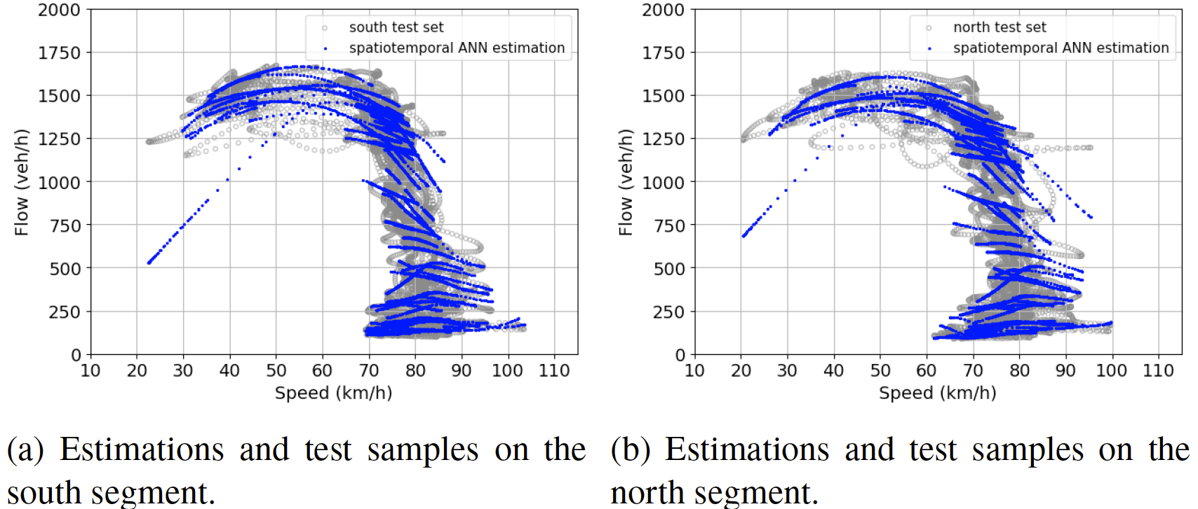
Spatial-Temporal ANN
Incorporating data from the north segment into training improves overall accuracy.
Location feature helps ANN learn the unique traffic flow characteristics for each road segment.
Additional training samples may help ANN learn a more comprehensive flow-speed relationship on the road.

Slide 40
Conclusion and Future work

Slide 41
Conclusion
We proposed an approach to estimate the traffic flow on highways based on artificial neural networks and mobile data.
It greatly improves the estimation accuracy by incorporating temporal factors into the estimation models.
Travel time as an additional input feature contributed tiny improvements and might slightly worsen the accuracy on the adjacent road segment.
Incorporating spatial factor and training data from adjacent road segments achieved a consistent and improved performance on both segments.
The approach provides a highly automated means to easily integrate new data sources and build estimation models effortlessly for a road network with heterogeneous and large-scale sensor data.

Slide 42
Future Work
Spatial-Temporal Correlations
Mining and utilize temporal and spatial correlations between neighboring data points in the time-space domain for traffic flow estimation or imputation.
Possible methods: Recurrent Neural Network (RNN), Convolution Neural Network (CNN), Graph Convolutional Network (GCN)
Traffic Prediction
Use mobile data as additional or standalone information for short-term traffic data prediction, e.g., traffic flow or speed prediction.
Possible methods: Long Short-Term Memory (LSTM), GCN
More Influencing Factors
Incorporating more influencing factors, e.g., number of lanes, weather, season, special event, as input features to improve the model’s accuracy and generality.

Slide 43
Thank You!

